Slide 1
Next Up:
Friedrich “Fred” Weinmann

Slide 2
3
3

Slide 3
2

Slide 4
1

Slide 5
Logging at Scale
Fred

Slide 7
So…
… have you heard about PSFramework?
https://psframework.org

Slide 8
Demos
Logging …
… and how it begins

Slide 9
Architecture
Script
Runspace 1-N
msg
Queues
Messages to Log
In-Memory Log
Instance 1
Instance 2
Instance N
Logging Runspace
msg
msg
msg
msg
msg

Slide 10
What the logging runspace does …
Initialize
Begin
Start
Message
Error
End
Final

Slide 11
Demos
Back in Action

Slide 12
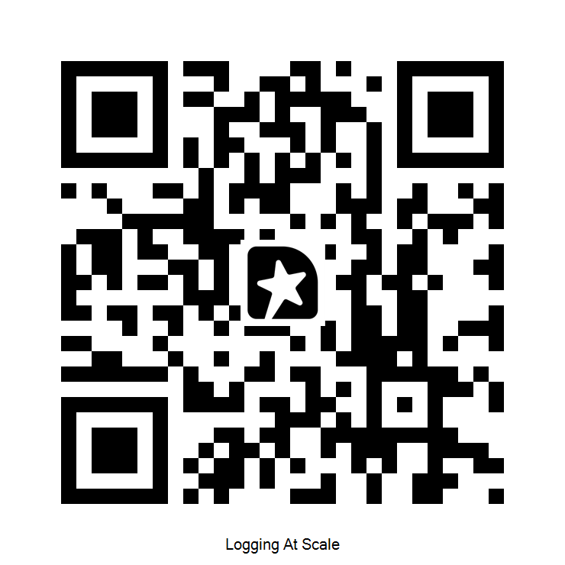
Q&A / Feedback

